Slide 1
FreeRTOS in Nucleo-64 ST board

Slide 2
Install STM32CubeMX
Go to the next page and download STM32CubeMX. After that install it.
https://www.st.com/content/st_com/en/products/development-tools/software-development-tools/stm32-software-development-tools/stm32-configurators-and-code-generators/stm32cubemx.html
This tool is used to configure the lower layers of the board.

Slide 3
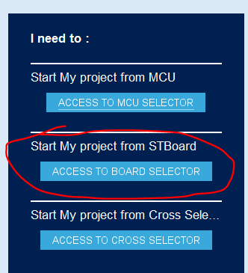
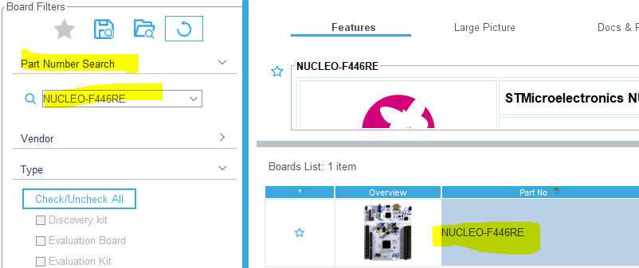
Configure a project for the board NUCLEO-F446RE
1) 2)

Slide 4
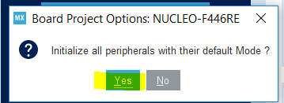
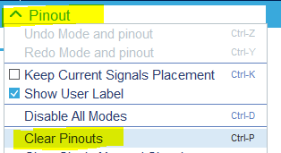
Configure a project for the board NUCLEO-F446RE
3) 4)

Slide 5
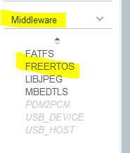
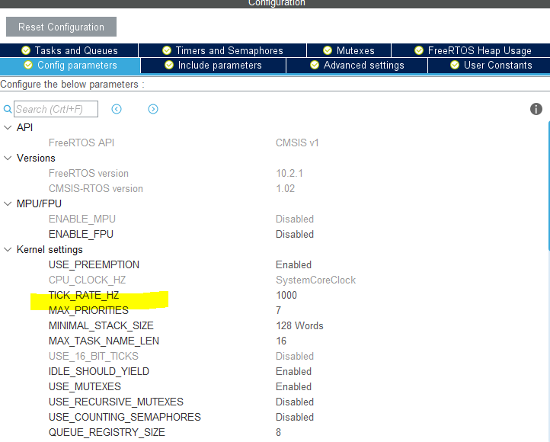
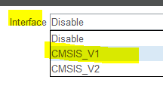
Configure FreeRTOS
5) 6) 7)
You can even add Task Queues and semaphores from here but it is not totally necessary the user can always add them directly in code using the know APIs for classic FreeRTOS.

Slide 6
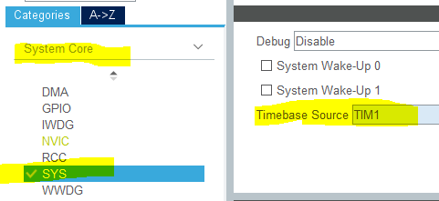
Select timer for the Tick
8)

Slide 7
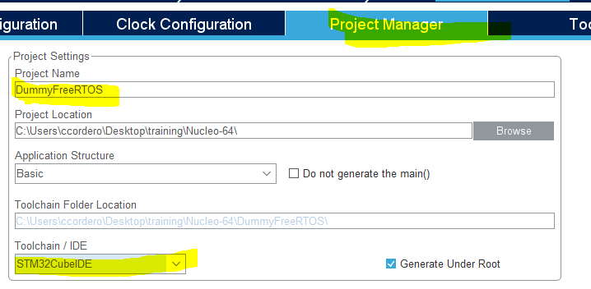
Configure the project
8)
Give a name and select a toolchain that are you going to use.

Slide 8

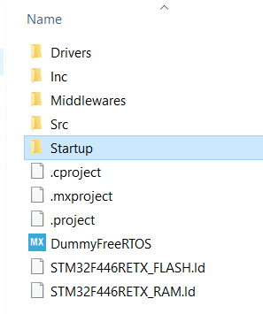
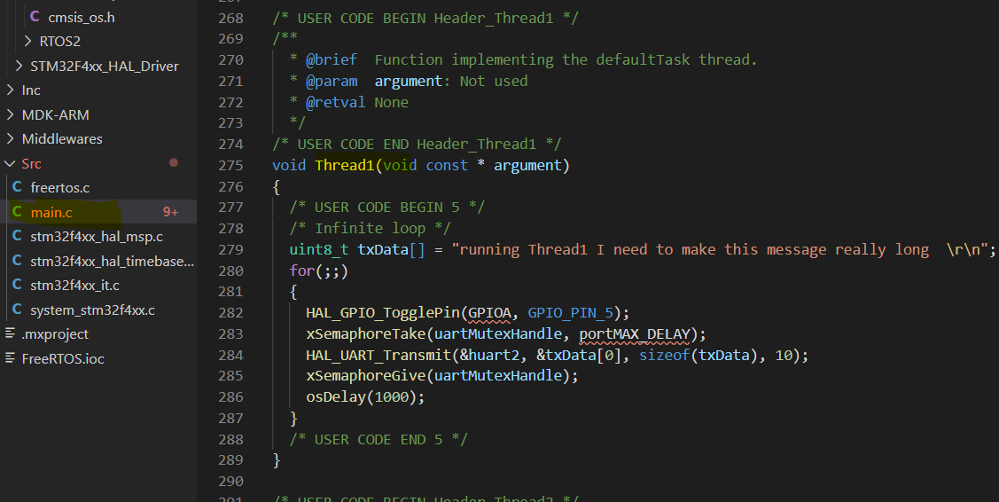
Generate Code
9) 10)
11)

Slide 9
Thanks!!

